Slide 1
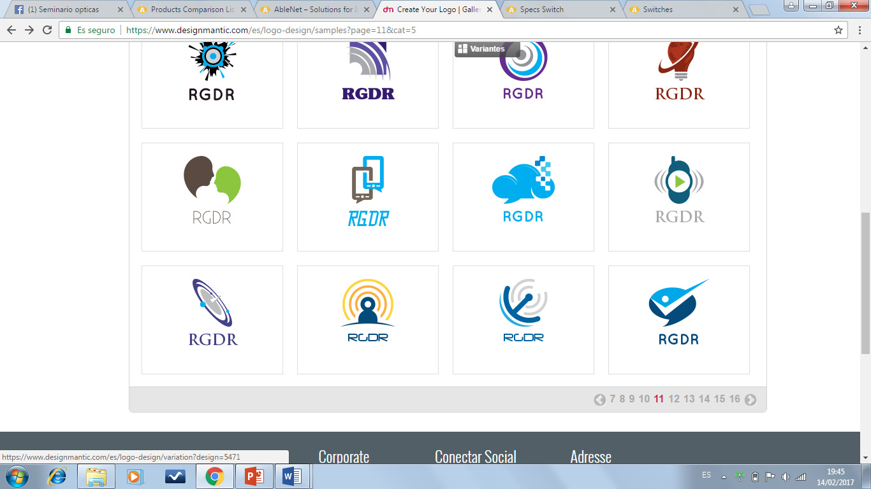
DESIGN OF A COMMUNICATION PROTOTYPE FOR PEOPLE WITH ENGINE NEURON DISEASES AND OTHER DISABILITIES
Members :
Lenin Dominguez
Gabriela Gamboa
Jazmin Rodriguez
Carlos Rosero

Slide 2
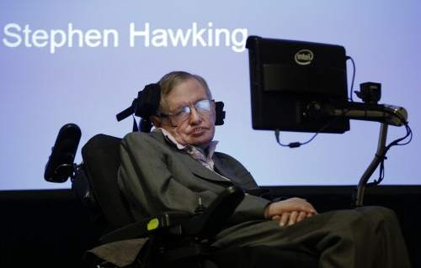
Stephen Hawking, one of the most recognized scientists in the world incorporate in his wheelchair a system of communication by means of an advanced technology that allows to develop diverse activities.

Slide 3
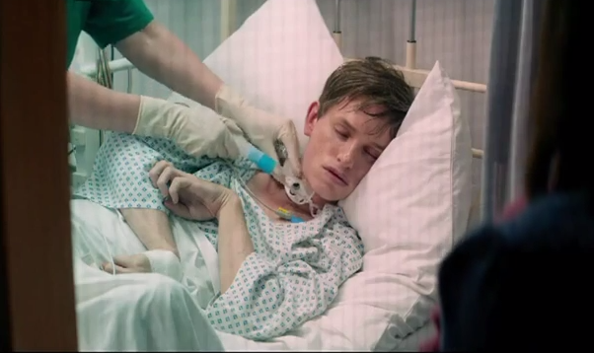
THE AMYOTROPHIC LATERAL SCLEROSIS
Is a degenerative disease of the neuromuscular type is the cause of a muscular weakness that becomes a paralysis that affects more and more parts of the body. From the muscles of the extremities, the paralysis extends to the respiratory apparatus and the patient can die if he does not use a respirator.
Approximately 30.000 people in the U.S
and 50 cases in Ecuador

Slide 4
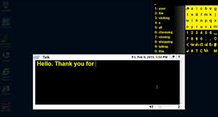
ACAT
ACAT is a software designed for Stephen Hawking with which he can communicate with the outside environment. This technology based on facial recognition can be incorporated into various medical applications related to disabilities, as in the case of Stephen with the simple movement of his cheek can activate previously programmed functions.

Slide 5
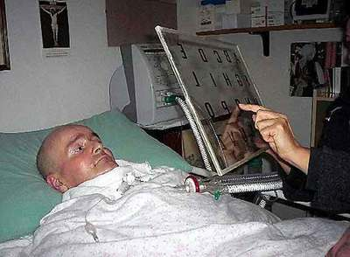
Objective
We wanted to develop a prototype that is economically accessible to all people who have amyotrophic lateral sclerosis like Stephen Hawking or who have similar diseases, so whit this prototype they can communicate quickly and efficiently.

Slide 6
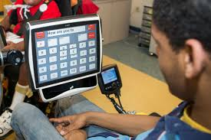
Description
Our prototype will allow its users to improve their quality of life to be able to perform one of the most daily tasks as is the speech that is so important since humans live in society and therefore it is important to be able to communicate with each other .

Slide 7
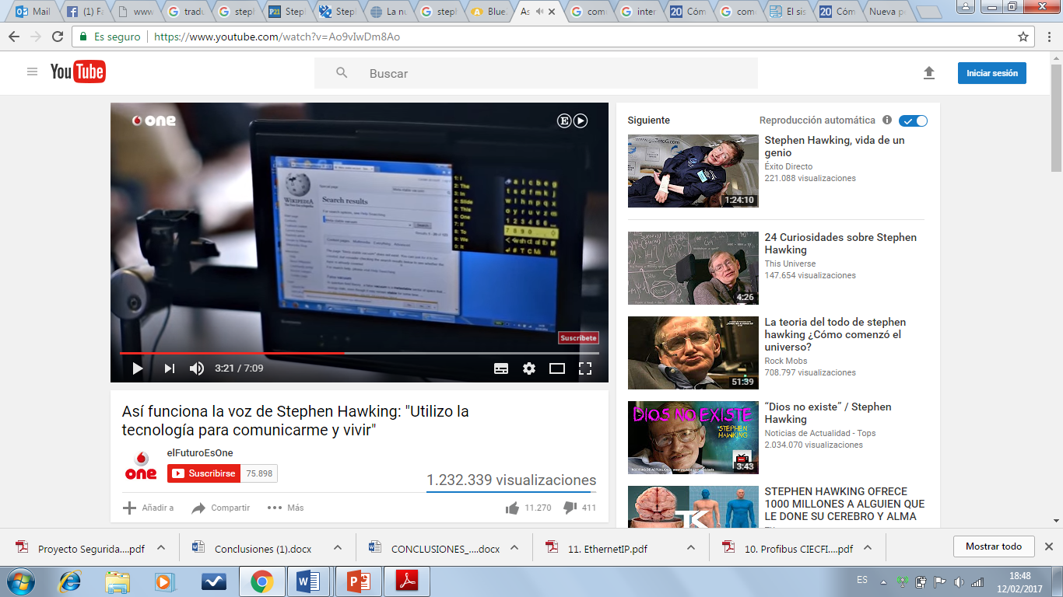
Description
Thinking about it our prototype will allow our clients to transmit thoughts faster and perform daily communication tasks in the tenth time as internet access, attach files, etc.

Slide 8
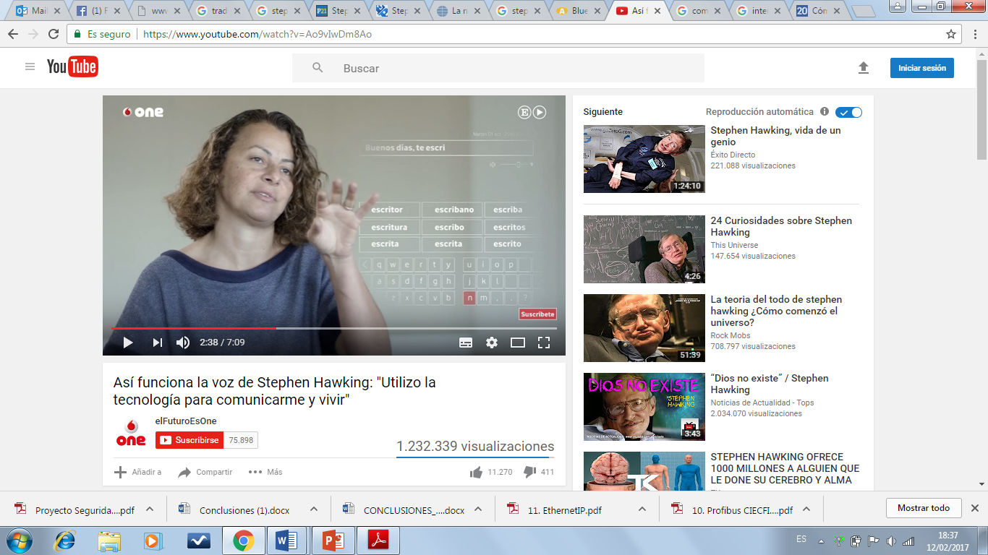
ACAT SOFTWARE
We decide to use this software because :
only write less than 20% of the total characters you want to communicate.
It is based on a predictive text algorithm similar to that incorporated in some smartphones

Slide 9
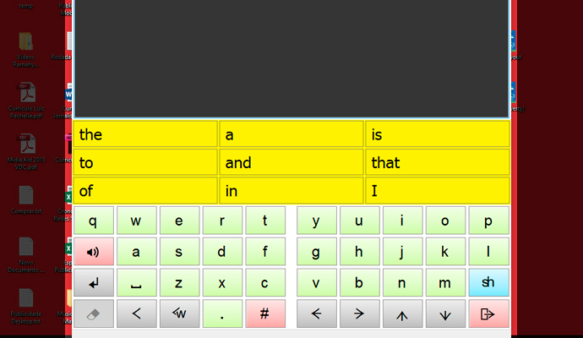
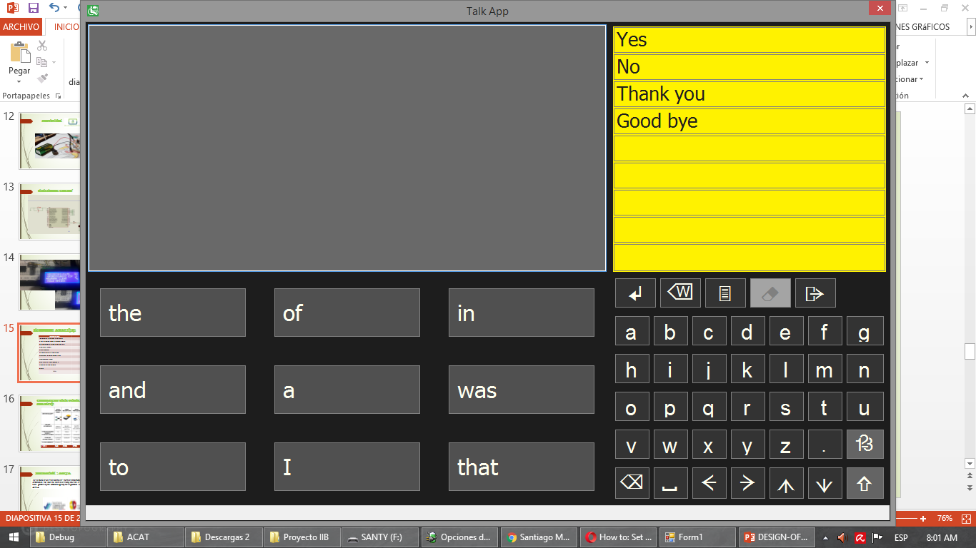
how does it work
The system is based on a predictive text algorithm able to guess the word that is trying to express from its first letters and learn the expressions that usually uses to speed up writing.

Slide 10
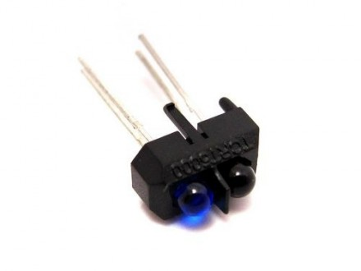
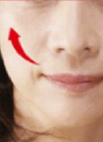
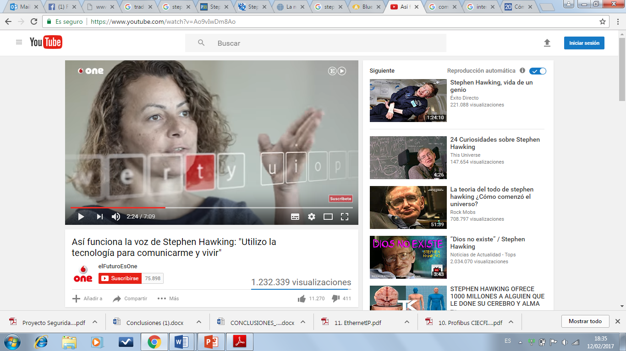


how does it work
The physical interface of the invention is formed by an infrared sensor which detects the movements of cheek, whereby the user can select characters and navigate through the on-screen menus.

Slide 11
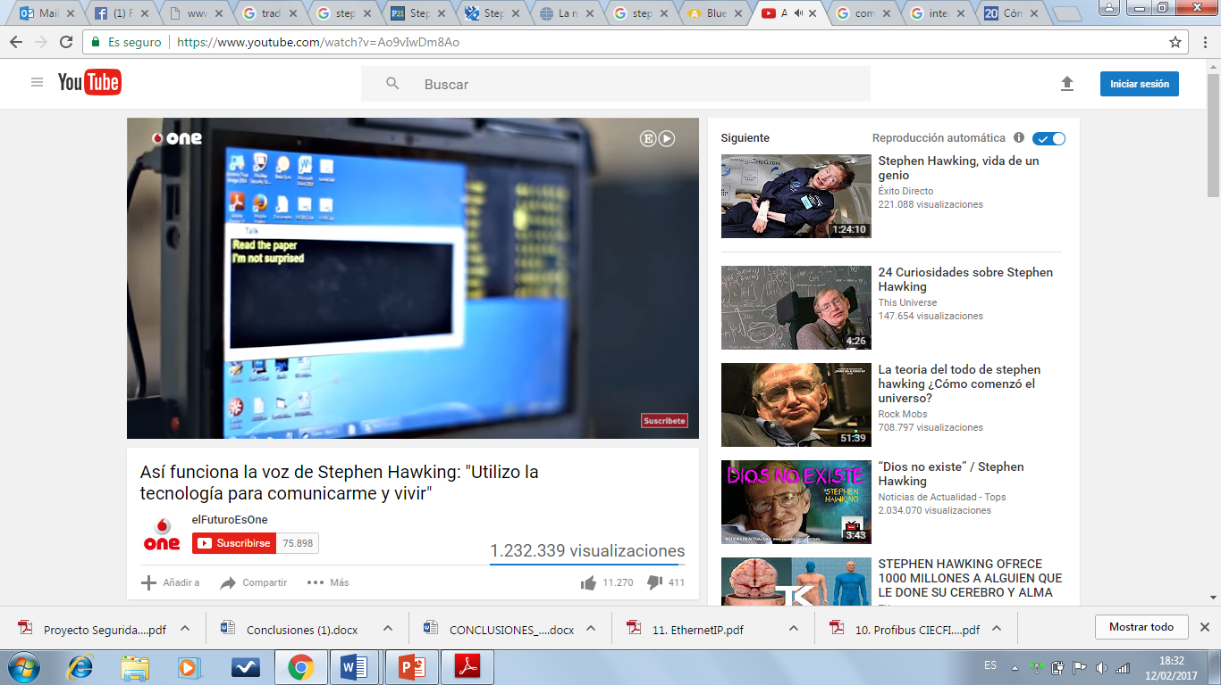
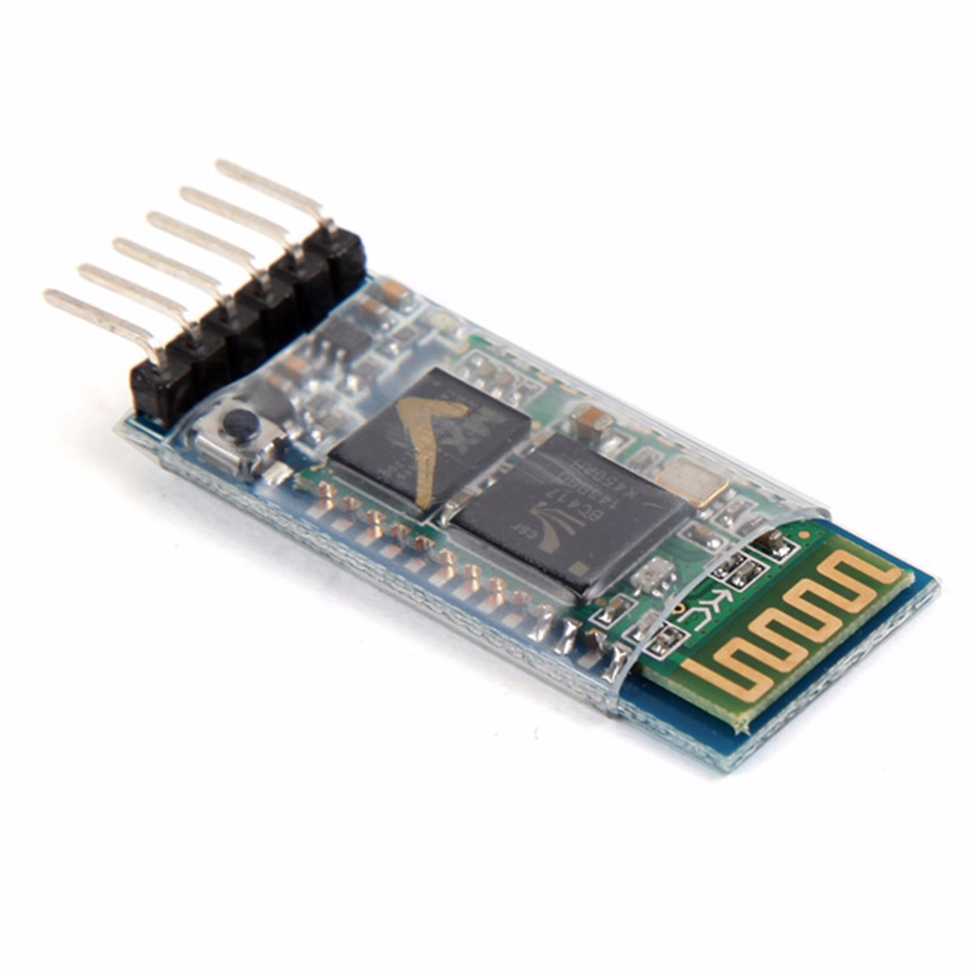
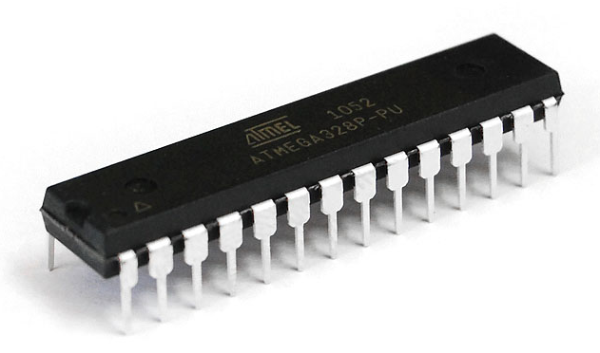
elements that our prototype has
Based on the study of the operation of the ACAT software will establish the best sensor (infrared )
The method of data acquisition will be designed by conditioning the signal sent by the sensor.
The best microprocessed system will be selected to obtain the signal generated by the sensor
The system of sending the acquired signal to the ACAT software is bluetooth

Slide 12
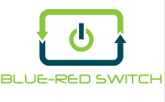
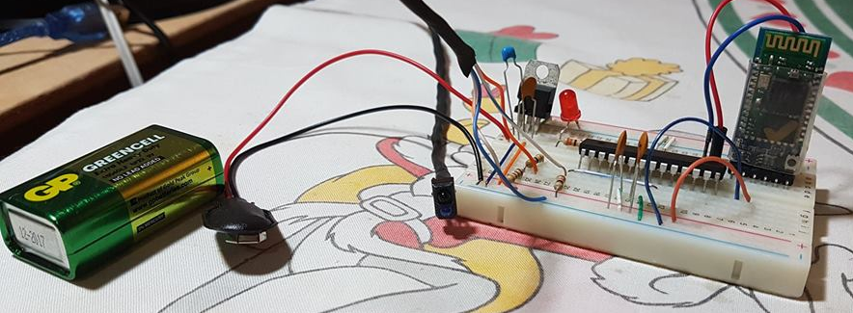
PROTOTYPE BY

Slide 13
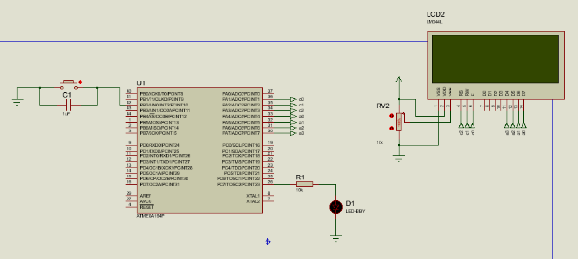
Electronic Circuit

Slide 14
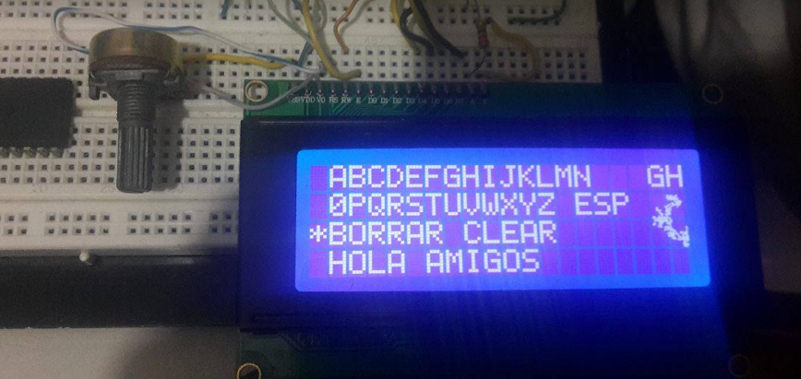
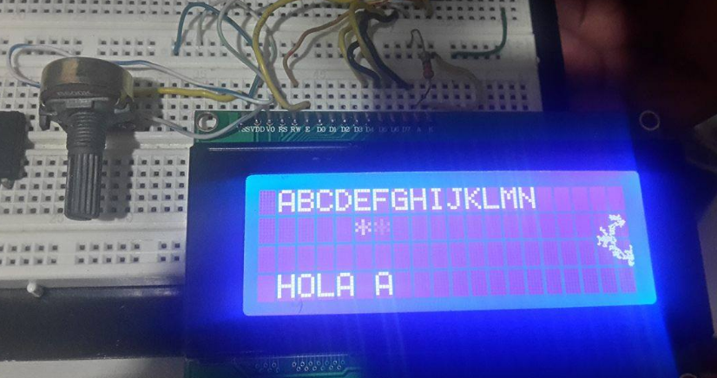
Results

Slide 15
economic analysis
DESCRIPTION | COST
INFRARED SENSOR TCRT5000 | $ 0.50
5 RESISTORS AND 3 CAPACITORS | $ 0.30
MICROPROCESSOR ATMEGA 328 | $ 6.50
CRYSTAL 8MHZ | $ 1.25
BLUETOOTH | $ 7.00
9V GREENCELL BATTERY | $ 3.50
VOLTAGE REGULATOR 7805 | $ 1.60
SOFTWARE ACAT | $0.00
UTP CABLE CATEGORY 5 | $ 1.00
ENGINEERING WORK | $20.00
CASE | $10.00
TOTAL | $51.65

Slide 16
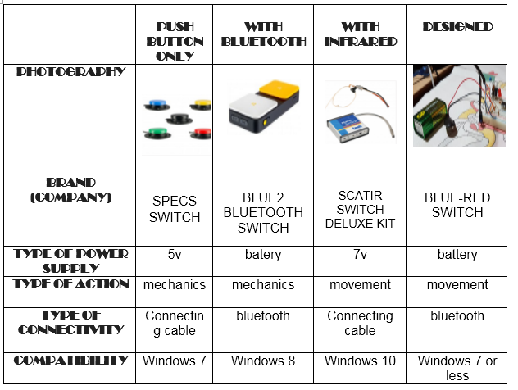
Comparison with other similar projects
PRICE | $65 | $185 | $725 | $51.65

Slide 17
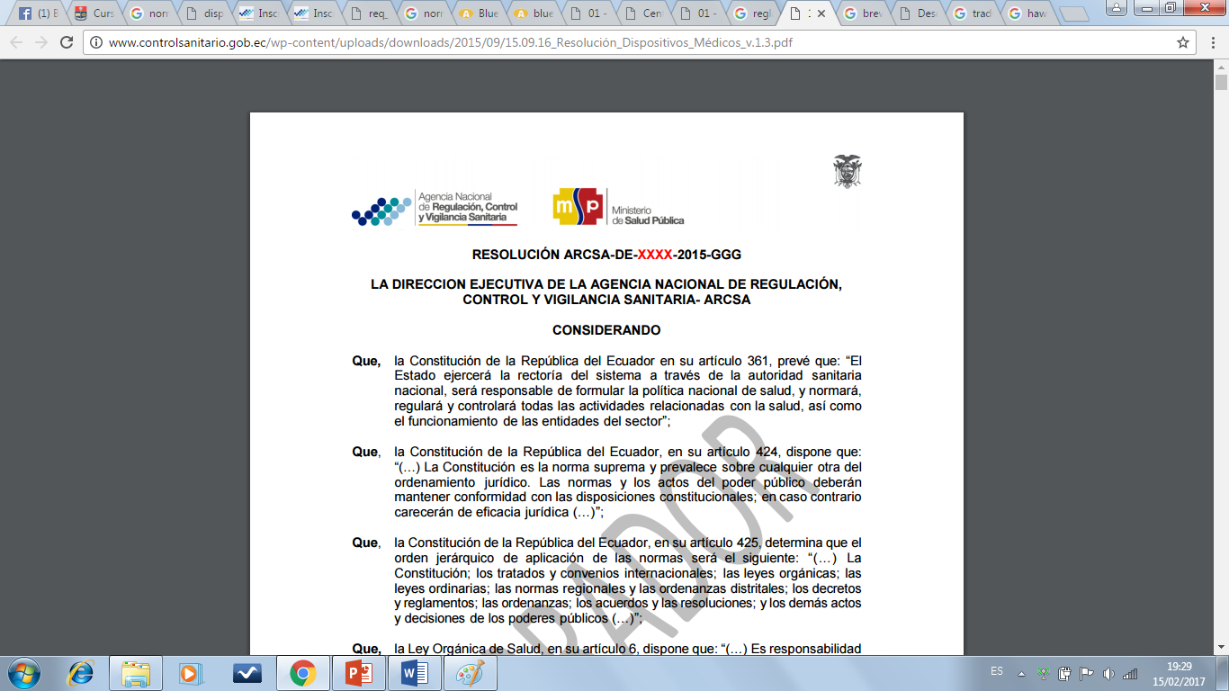
NormativE : ARCSA
The medical devices for human use, for their manufacture, import, export, storage, distribution, sale and sale must necessarily have the respective sanitary registration in force, granted by the National Agency for Regulation, Control and Sanitary Surveillance - ARCSA

Slide 18

NormativE : ARCSA CAP IV OBTEINING THE HEALTH REGISTER
REQUIREMENTS FOR DEMONSTRATING :
SAFETY OF THE FINISHED PRODUCT
EFECTIVENESS OF THE FINISHED PRODUCT
QUALITY OF THE FINISHED PRODUCT

Slide 19
NormativE : ARCSA CAP IV OBTEINING THE HEALTH REGISTER
General information on the medical device for human use (Trade name,
Description of the indications of use, Commercial presentation, Name,
city and country of manufacturer (s), Date of elaboration, Expiry date,
List of accessories)
Description of the functional components
Parts and structure of the medical device for human use
Manufacturing process information
Information about the control of the finished product Certificate of quality analysis or declaration of conformity

Slide 20
Conclusion
The electronic prototype was developed fulfilling the requirements of the objectives proposed in the project for which the software was developed and the electronic circuitry was implemented obtaining the results previously presented.
This system that will help people who are unable to communicate due to amyotrophic lateral sclerosis disease or the like has the advantage over others because of its economic price, size and adaptability.
The low cost of the product and its easy installation will make the prototype more accessible in the market, reaching people with low resources who need it.
Currently the majority of the population has computers with bluetooth availability and for this reason the prototype reaches many homes.

Slide 21


